Slide 1

8th Grade Math: Pre-Algebra
Unit 8, Lesson 9 Solving Systems by Graphing Volume 2, pg. 44

Slide 2


Benchmark
MA.8.AR.4.3
Given a mathematical or real-world context, solve systems of two linear equations by graphing.
volume 2, pg. 44

Slide 3
Integrated Mathematical Thinking and Reasoning Standards
MA.K12.MTR.4.1 Engage in discussions that reflect on the mathematical thinking of self and others.
MA.K12.MTR.5.1 Use patterns and structure to help understand and connect mathematical concepts.
MA.K12.MTR.6.1 Assess the reasonableness of solutions.
volume 2, pg. 44

Slide 4

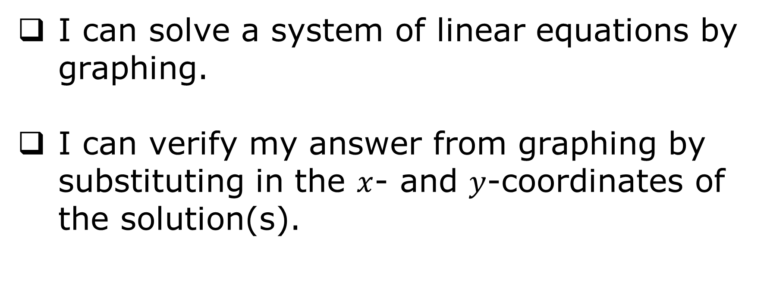
Learning Targets
I can solve a system of linear equations by graphing.
I can verify my answer from graphing by substituting in the $x$- and $y$-coordinates of the solution(s).
volume 2, pg. 44

Slide 5

Warm-Up
volume 2, pg. 45

Slide 6
8.9.1 Warm-Up: Which One Doesn’t Belong?
The graphs of four systems of equations are shown.
System A | System B
volume 2, pg. 45

Slide 7
System C | System D
Which graph does not belong?
Explain your reasoning.
volume 2, pg. 45

Slide 8

Collaboration
volume 2, pg. 45

Slide 9

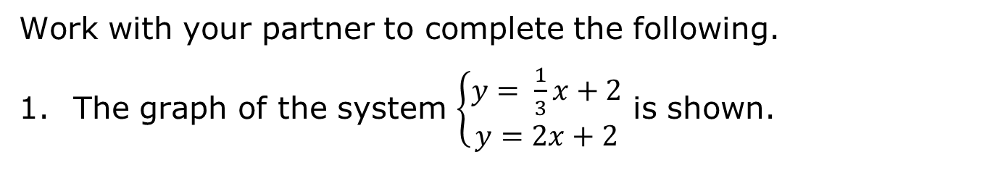
8.9.2 Collaboration: Solving Systems from Graphs
Work with your partner to complete the following.
The graph of the system $\left\{\begin{aligned}y= \frac{1}{3}x+2 \\ y=2x+2\end{aligned}\right.$ is shown.
volume 2, pg. 45

Slide 10
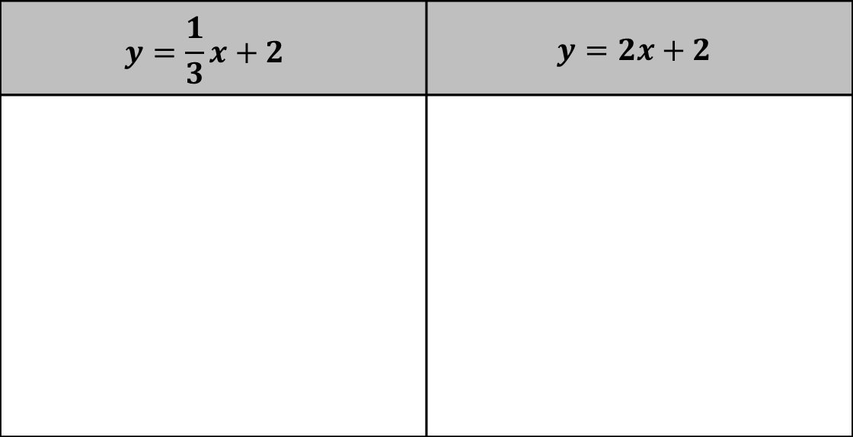
Mark the solution to the system on the graph.
What are the coordinates of the solution to the system?
Verify the solution using substitution.
$$y=\frac{1}{3}x+2$$ | $$y=2x+2$$
volume 2, pg. 45

Slide 11

The graph of the system $\left\{\begin{aligned}&y= 4 \\ &y=\frac{1}{2}x−1\end{aligned}\right.$ is shown.
Mark the solution to the system on the graph.
What are the coordinates of the solution to the system?
Verify the solution using substitution.
volume 2, pg. 46

Slide 12

Use the coordinate plane to complete the following.
Graph $y= 3x−3$ on the coordinate plane.
Graph $y= \frac{1}{2}x+2$ on the coordinate plane.
volume 2, pg. 46

Slide 13
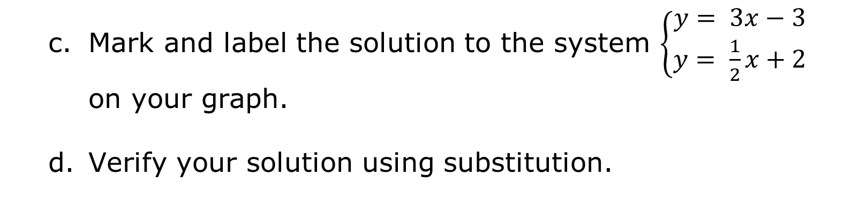
Mark and label the solution to the system $\left\{\begin{aligned}y= 3x−3 \\ y= \frac{1}{2}x+2\end{aligned}\right.$ on your graph.
Verify your solution using substitution.
volume 2, pg. 46

Slide 14

Guided Instruction
volume 2, pg. 47

Slide 15

8.9.3 Guided Instruction: Approximating Solutions
The graph of the system $\left\{\begin{aligned}&x=3.5 \\ &y=\frac{2}{3}x+2\end{aligned}\right.$ is shown.
Mark the solution to the system of equations.
volume 2, pg. 47

Slide 16
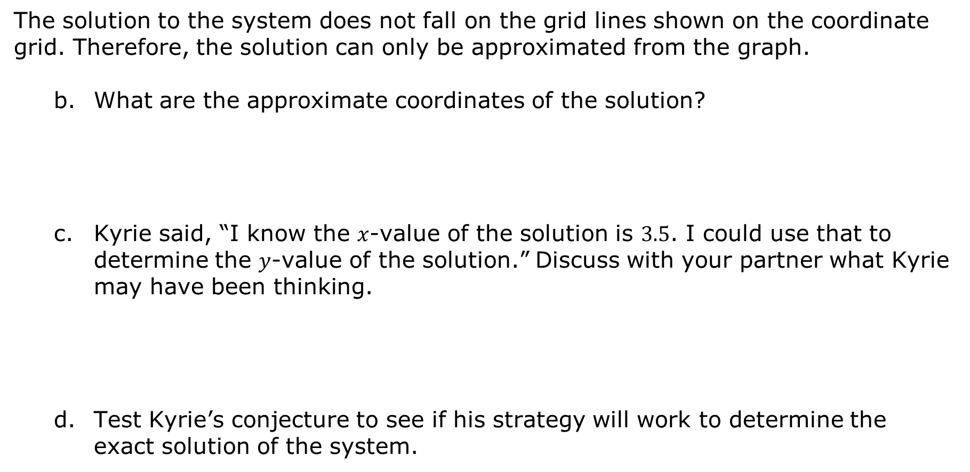
The solution to the system does not fall on the grid lines shown on the coordinate grid. Therefore, the solution can only be approximated from the graph.
What are the approximate coordinates of the solution?
Kyrie said, “I know the $x$-value of the solution is $3.5$. I could use that to determine the $y$-value of the solution.” Discuss with your partner what Kyrie may have been thinking.
Test Kyrie’s conjecture to see if his strategy will work to determine the exact solution of the system.
volume 2, pg. 47

Slide 17

Use the coordinate plane to complete the following.
Graph the system $\left\{\begin{aligned}&y= −\frac{3}{4}x+4 \\ &y= 3x−4\end{aligned}\right.$ on the coordinate plane.
volume 2, pg. 47

Slide 18
Mark the solution to the system on your graph.
What are the approximate coordinates of the solution?
volume 2, pg. 47

Slide 19

Exploration
volume 2, pg. 48

Slide 20


8.9.4 Exploration: Relationships in Parallel Lines
Use the coordinate grid to complete the following.
Graph the system$\left\{\begin{aligned}y= −\frac{1}{3}x+4 \\ y= −\frac{1}{3}x−4\end{aligned}\right.$ .
volume 2, pg. 48

Slide 21
Compare your graph with your partner and resolve any differences, if necessary.
Discuss with your partner the solution(s) to the system based on your graphs.
Work with your partner to determine which statements are true for this system. Then, check all the true statements.
The two lines are perpendicular.
There is no solution to the system.
There are no points that lie on the graph of both lines.
There are infinitely many solutions to the system.
Any point will make both equations true.
The two lines are parallel.
volume 2, pg. 48

Slide 22
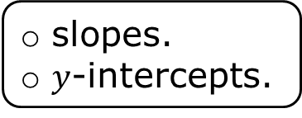
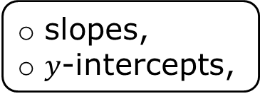
Compare the two equations in the system. Discuss with your partner what is the same and what is different about the equations.
Complete the statements.
A system of equations that has no solutions occurs when the lines are The equations of lines have the same but different
parallel.
perpendicular.
parallel
perpendicular
slopes,
$y$-intercepts,
slopes.
$y$-intercepts.
volume 2, pg. 48

Slide 23

Bring It Together
volume 2, pg. 49

Slide 24

8.9.5 Bring It Together: Solutions to Systems of Equations
The table gives three descriptions of the types of solutions to systems of linear equations. Match each description to the number of solutions the system has.
Description of the System | Number of Solutions
All the ordered pairs that satisfy one equation will also satisfy the other equation. | one solution no solutions infinitely many solutions
Exactly one ordered pair will satisfy both equations. It is the point of intersection of the graphs. | one solution no solutions infinitely many solutions
There are no ordered pairs that will satisfy both equations. | one solution no solutions infinitely many solutions
volume 2, pg. 49

Slide 25
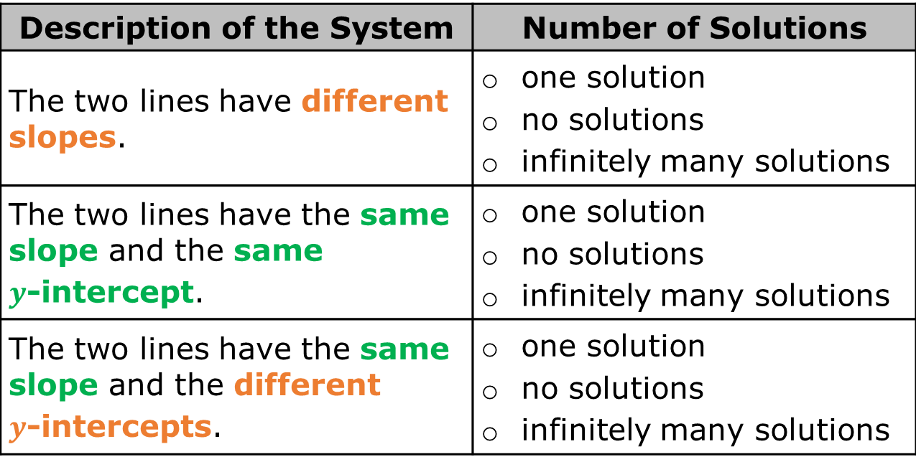
The features of the equations in different types of systems of two linear equations are given. Match each description to the number of solutions the system has.
Description of the System | Number of Solutions
The two lines have different slopes. | one solution no solutions infinitely many solutions
The two lines have the same slope and the same $y$-intercept. | one solution no solutions infinitely many solutions
The two lines have the same slope and the different $y$-intercepts. | one solution no solutions infinitely many solutions
volume 2, pg. 49

Slide 26

Wrap-Up
volume 2, pg. 49

Slide 27
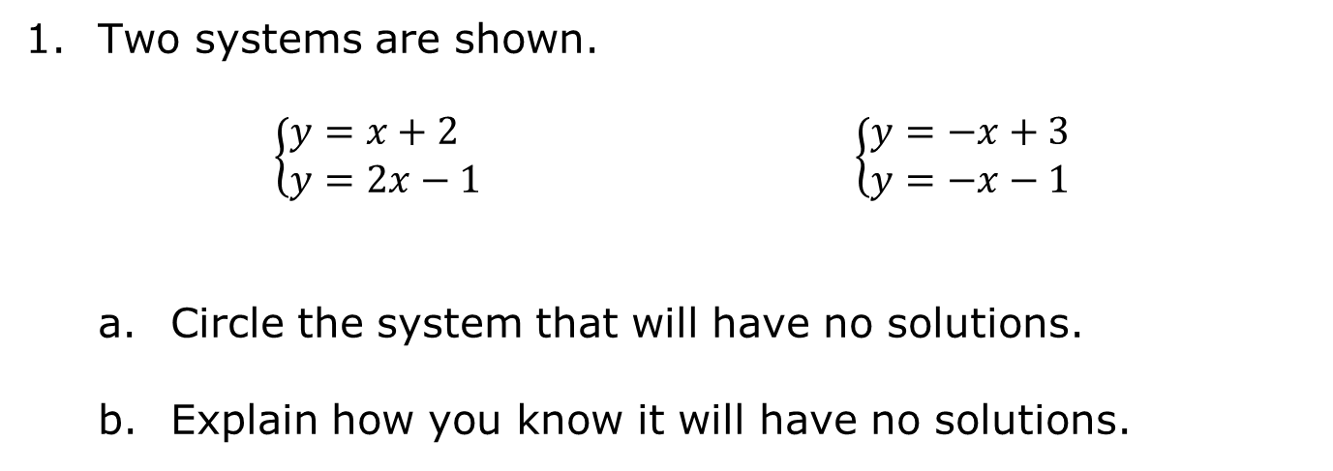
8.9.6 Wrap-Up: Ticket Out the Door
Two systems are shown.
$\left\{\begin{aligned}&y=x+2 \\ &y=2x−1\end{aligned}\right.$ $\left\{\begin{aligned}y=−x+3 \\ y=−x−1\end{aligned}\right.$
Circle the system that will have no solutions.
Explain how you know it will have no solutions.
volume 2, pg. 49

Slide 28
Graph the system you did NOT circle in Part A. Then, write the solution under the coordinate plane.
Solution (____, ____)
volume 2, pg. 49

